Slide 1

Suicide Awareness and Prevention
Hinsdale Middle/High School
March 2021

Slide 2

Every year, schools across the country take the time to talk to students about some very serious topics.
Suicide Awareness and Prevention is one of those topics.
This Photo by Unknown author is licensed under CC BY-ND.

Slide 3

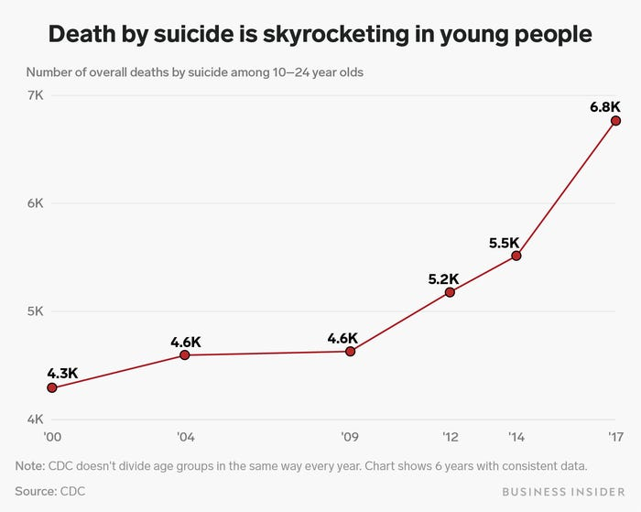
Why do we need to talk about this?

Slide 4
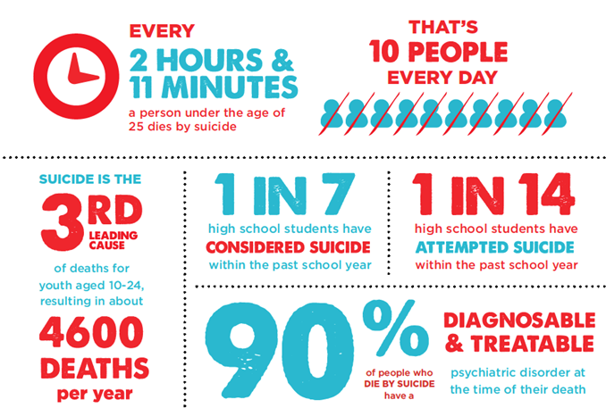

Slide 5

Thoughts of Suicide can affect Anyone

Slide 6


#1 Myth – If I ask someone if they are thinking about killing themselves, it will give them the idea and encourage them to do it.
FALSE: Research shows that asking someone if they are thinking about suicide will not put the idea in their head or push them into action. In fact, asking someone directly, “Are you thinking about killing yourself?” may be the question to help save their life.

Slide 7

What can you do if you're worried about someone?
What should you say?
Or Do?

Slide 8
Some Warning signs
Acting differently
Less interest in school, friends, activities
Trouble sleeping
Excessive crying
Talking or writing about death
Talking about a plan to end their life

Slide 9

How to help
* Let them know you care * Ask how you can help *Ask if they are thinking about suicide
If they say yes, or you have reason to believe they are serious:
Take. Them. Seriously.
Don't keep it a secret
Offer to support them in getting help
Avoid trying to "cheer them up" or giving them a lecture
TAKE ACTION – with or without them

Slide 10

Here's HOW to get help
As soon as possible (ASAP) is what matters!
You can go to a counselor in person, write a note and hand it to a teacher, or go see the school nurse and tell her.
There are other creative ways to call someone's attention to this. You can be assured – your concerns WILL be given attention!

Slide 11
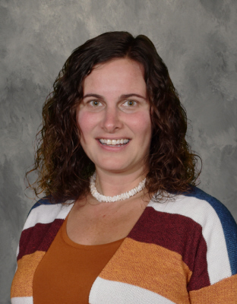


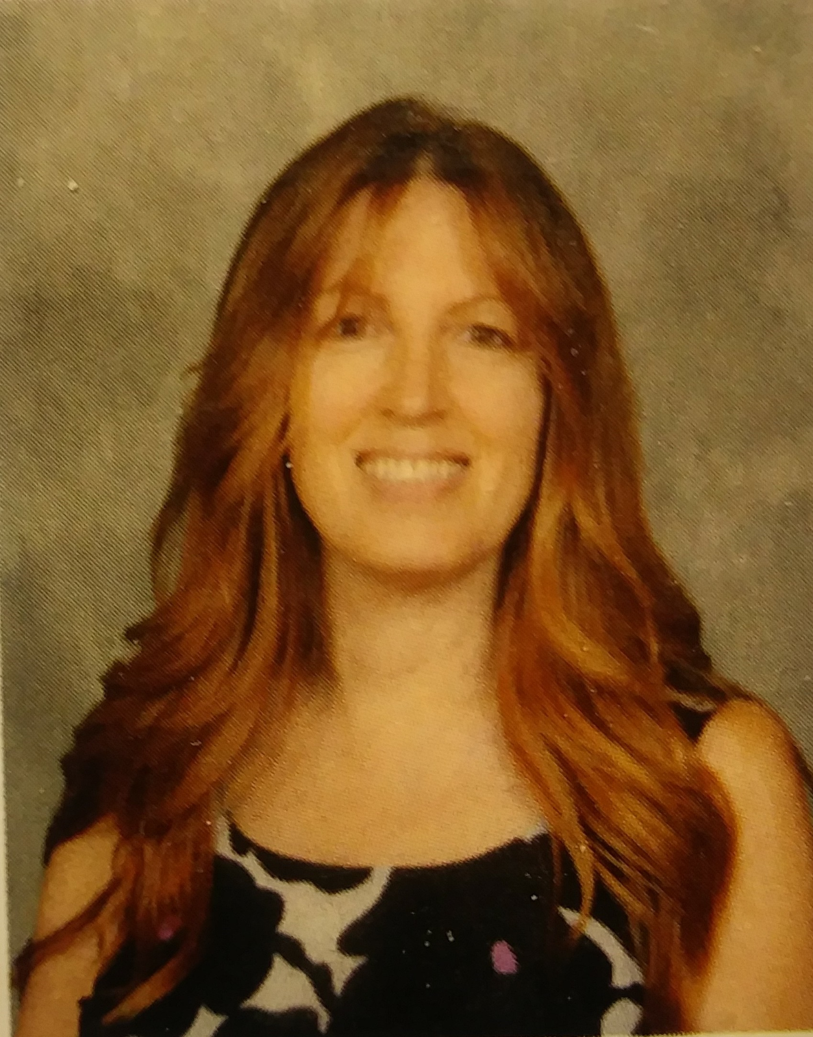

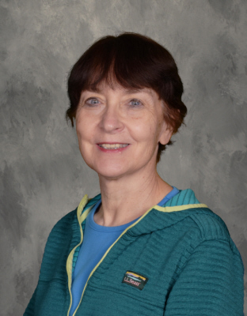
WHO can you see here at school for help?
Ms. Diorio
School Counselor
Mr. Crawford
School Counselor
Mr. Fleming
School Social Worker
Ms. Drogue
School Psychologist
Mrs. Zalneraitis
School Nurse

Slide 12

If you talk to a counselor about a concern for someone else, every effort is made to get the person help without saying who reported the information.
The focus is on getting help.
Parents and/or outside agencies are contacted if a concern turns out to be valid and a student needs help.
If a student talks to a counselor about their own thoughts and feelings, the information is kept confidential unless the person has been harmed, or has thoughts about harming themself or someone else.

Slide 13

So, usually, your conversation with a school counselor is kept private. EXCEPT WHEN:
A student poses a danger to them selves
A student poses a danger to others
A student has been harmed by someone else

Slide 14


Other sources of help:
Help is also available 24/7 from these two crisis lines

Slide 15

Prevention: healthy choices and coping strategies
Joyful Activities
Engage in or return to activities or hobbies that have brought you joy in the past. Consider trying something new that looks fun.
Connect
Reach out to friends and family even to people who you've lost contact with. Text or message them. Ask someone you trust, "I'm looking for someone to talk to … do you have a few minutes?"
Write/Record
Write in a journal or make a video of the positive things in your life, your goals and dreams, the things that make you happy. Read (or watch) this during times when you are feeling stuck.
Remember
Think about what has gotten you this far. The strategies that have worked for you in the past are often helpful for solving new problems.
Practical Actions: Exercise, sunshine, and healthy habits and routines for sleeping, for eating, and for socializing.

Slide 16

This was a lot of information.
If you have some unexpected strong feelings or unanswered questions after the end of this presentation, the school counselors are making themselves available all throughout the day today.
You can ask to see any one of the counselors at any time today, or you can stop into the school counseling office and ask to speak with a counselor, the social worker, or the school psychologist.
You can also submit an appointment request electronically.

Slide 17

This PowerPoint will be posted to the Guidance link on the school website.

